Slide 1

Social Buzz Management Report
Analyzing Social Buzz’s content strategy, user engagement, and data insights.
by Patrick Sebastine
Date: October 2024
PS

Slide 2

Problem Statement
Analyzing Content to Drive Engagement and IPO Success
1
Purpose
To provide actionable insights into content popularity and user engagement for scaling and IPO preparation.
2
Audience
Social Buzz management team and stakeholders.
3
Business Problem
How can Social Buzz optimize content strategies to enhance user engagement and effectively scale for an IPO?

Slide 3

Proposed Solution
Data-Driven Content Strategy
Leverage Data
User engagement scores, sentiment analysis, and content performance.
Solution Strategy
To guide future content strategies and growth plans.

Slide 4
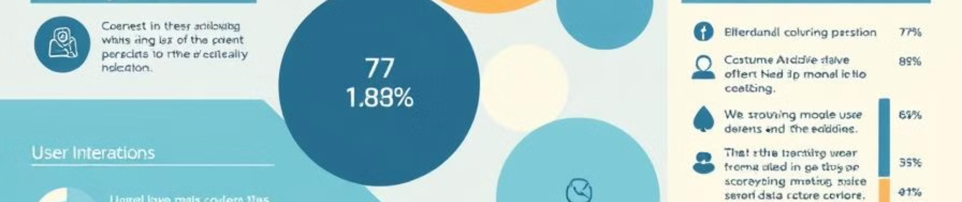
Background
Client Overview and Project Context
Social Buzz
Content Management
Growing platform aiming to scale and prepare for IPO.
Key factor for sustained growth and user engagement.

Slide 5
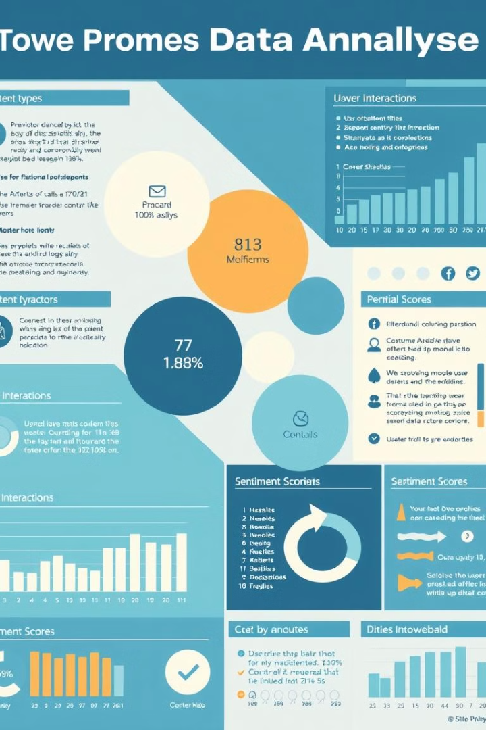
Dataset Overview
Key Data Points
Source
Social Buzz Platform Data
Years
2020-2021
Key Variables
Content type, user engagement scores, sentiment, categories, and content categories.
Insights
Content performance was measured based on user interactions across different types and categories.

Slide 6
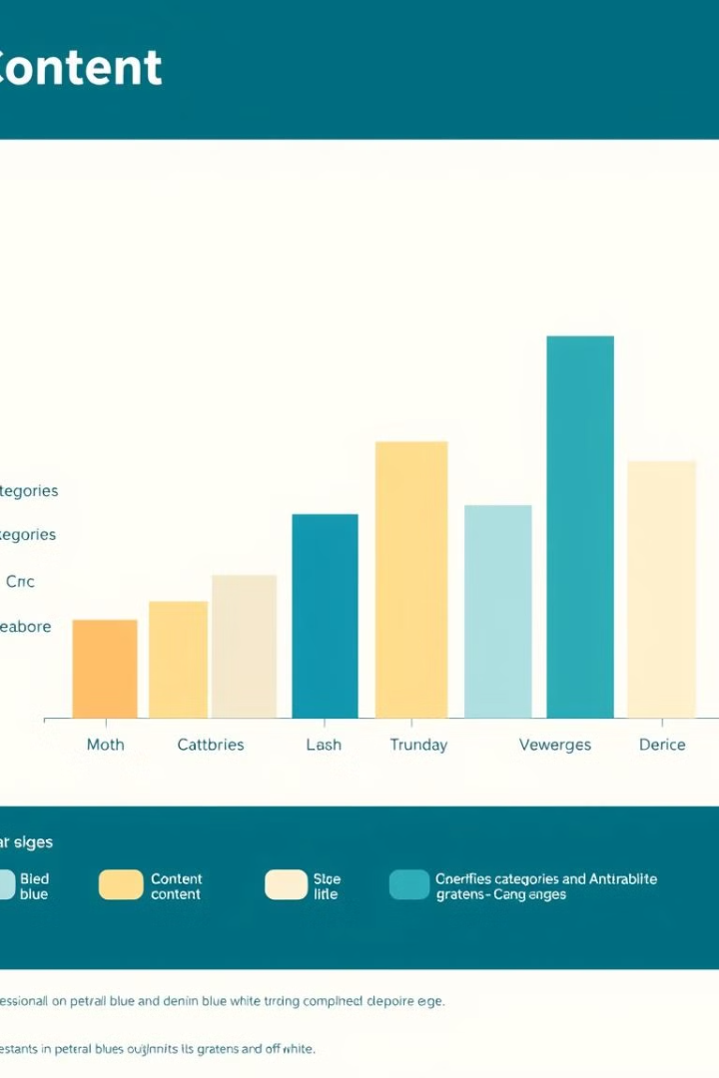
Analysis Goals
Analyzing Content Popularity
1
WHY
To identify content driving most engagement.
2
HOW
By analyzing user engagements, sentiment, preferences, and monthly performance.
3
WHAT
To deliver insights that can help priortize content and optimize engagement strategies.

Slide 7
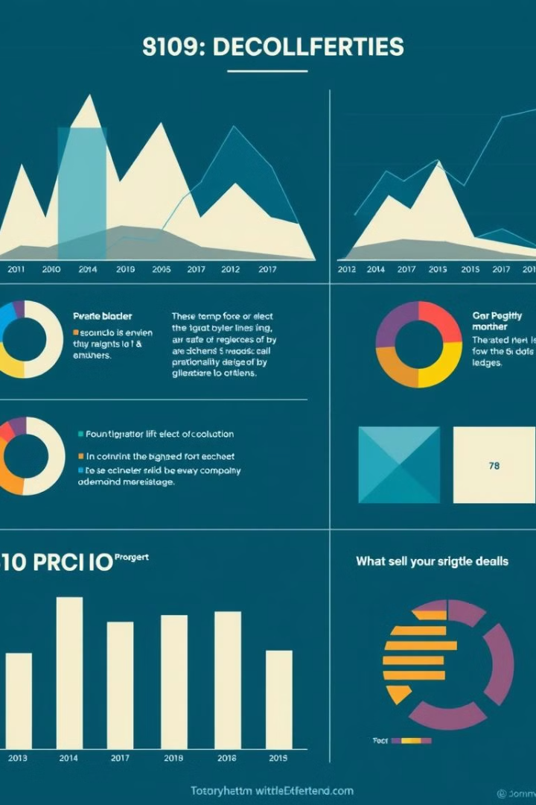
Key Insight
Top Findings from the Analysis
1
Sentiment Distribution
Positive (85%), Neutral (9%), Negative (7%).
2
Content Type Popularity
Photos, Videos, GIFs, and Audio drive the most engagement.
3
Top 5 Categories
Animals, Science, Healthy Eating, Technology, Travel, and Food.
4
Monthly Trends
Users total engagement peaked in May, January, and October.

Slide 8
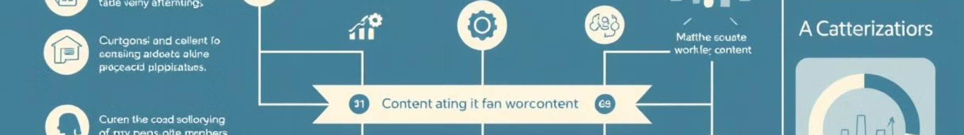



Recommendations
Strategic Actions for Growth
Prioritize Content
Focus on top-performing types (photos and videos).
Category Focus
Create more content in high-engagement categories (animals and science).
Sentiment Optimization
Address negative sentiment for improved user experience.

Slide 9



Key Challenges, Assumptions, and Risks
Considerations and Constraints
Challenges
Balancing content diversity and high engagement.
Assumptions
Data accurately reflects platform activities and user trends.
Risks
Changes in user behavior could impact engagement strategies.

Slide 10

Next Steps
Future Work for Scaling and IPO Readiness
Conduct a full audit of Social Buzz’s big data practices.
Collaborate with technical teams for scalability and platform optimization.
Test new content strategies based on data insights.

Slide 11

Thank You
Q&A
We're happy to answer any questions or further discussions.

Slide 12
